Slide 1


Archie Goli
9/3/2023

Slide 2

Outline
Introduction
Executive Summary
Methodology
Results
Conclusion
Appendix

Slide 3
Introduction
Commercial spaceflight has become a reality over the past few decades.
Perhaps the most successful company in the running is SpaceX.
This is because their rocket launches (in the context of Falcon 9) are relatively inexpensive ($62 million vs. upwards of $165 million).
The reason SpaceX launches are inexpensive is because they can reuse the first stage of their rocket for every launch.
In this project, we seek to determine whether the first stage of the rocket can land to estimate the relative cost of a given launch.

Slide 4
Executive Summary
In this project, we:
Extracted data through an open-source SpaceX REST API and used web scraping to gather additional historical data
Conducted exploratory data analysis through SQL, Matplotlib, and Pandas
Created visualizations using Folium and generated an interactive analytical dashboard of results with Python’s Plotly and Dash frameworks.
Trained three different machine learning models (Decision Tree Classifier, K-Nearest Neighbors, and SVM) and analyzed which would be the most accurate at predicting whether a given launch would land the first stage successfully.
Overall, it was determined that approximately 65-70% of all SpaceX launches typically land their first stages successfully.

Slide 5

Section 1

Slide 6
Methodology
Executive Summary
Data collection methodology:
2 methods: SpaceX REST API + Web scraping through Python
Perform data wrangling
Examined success rate by orbit type, launch site location, and payload mass
Perform exploratory data analysis (EDA) using visualization and SQL
Perform interactive visual analytics using Folium and Plotly Dash
Perform predictive analysis using classification models
Built and evaluated 3 different machine learning models on key performance indicators, including accuracy and confusion

Slide 7
Data Collection
Data was collected through two sources:
SpaceX REST API → open-source API with information on all Falcon 9 launches
Used specific endpoints to retrieve data such as landing status, payload mass, type of landing (drone ship, ocean), etc.
Web scraping on Wikipedia
The Wikipedia site on SpaceX Falcon 9 launches includes more relevant information on the launches conducted to this day.

Slide 8
Data Collection – SpaceX API
Send GET Requests to specific child endpoints (/rockets, /launchpads, etc.)
Retrieve response in JSON format
Convert JSON to Pandas dataframe for cleaning + wrangling
The open-source SpaceX API was accessible through a parent endpoint: https://api.spacexdata.com/v4/
The notebook with API calls and results is stored on GitHub and can be accessed through this link.

Slide 9
Data Collection - Scraping
Webscraping was conducted with the BeautifulSoup library in Python.
Launch records were retrieved from a Wikipedia Page titled “List of Falcon 9 and Falcon Heavy Launches” (accessible here).
Data such as the version of the booster, the status of the landing, the launch site, and payload mass, as well as the dates and times of the launch and landing, were recorded.
The notebook with webscraping results is stored on GitHub and can be accessed through this link.

Slide 10
Data Wrangling
Calculated the number of launches at each launch site, separated by the types of orbits (LEO, VLEO, GTO, SSO, etc.)
GTO (Geosynchronous Orbit) was the most common type of orbit for rocket launches, followed by ISS (International Space Station) and VLEO (Very Low Earth Orbit)
Approximately 67% of launches from 2010 to 2020 had successful first-stage landings, and 62% of successful landings were on drone ships
The notebook with data wrangling results is stored on GitHub and can be accessed through this link.

Slide 11
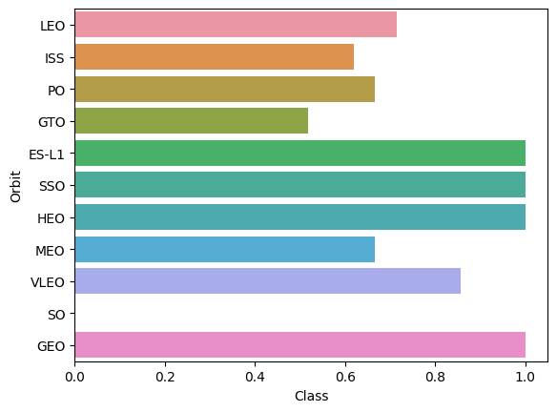
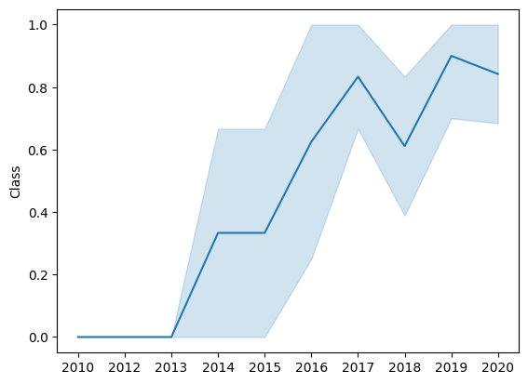
EDA with Data Visualization
Exploratory Data Analysis was used to visualize what factors were most important in determining the success of a first-stage landing.
We generated visualizations that demonstrated the success rate of each landing by type of orbit, as well as the historical success rate of landings from 2013 to 2020 (seen below).
The notebook with data exploration results is stored on GitHub and can be accessed through this link.

Slide 12
EDA with SQL
Additional exploratory analysis was conducted through SQL for more powerful and meaningful results.
Through this analysis, we determined that the overall mission success is not necessarily correlated to the success of the landing or even launch.
Within the dataset (which contained 101 launches from 2010 – 2020), 100 missions were successful, while only 1 was a mission failure.
The average payload mass for each launch was found to be 2,534.67 kilograms, and the first successful landing outcome was achieved in 2015.
The notebook with SQL data exploration results is stored on GitHub and can be accessed through this link.

Slide 13
Build an Interactive Map with Folium
Folium was used to generate geographical representations of launch sites within the dataset.
Each launch site was denoted with an orange dot, and the clustering of launch sites was usually in 3 locations: Florida, Texas, and California.
In addition, launch sites were close to the coast and away from densely populated areas.
The notebook with Folium visualization results is stored on GitHub and can be accessed through this link.

Slide 14
Build a Dashboard with Plotly Dash
Through exploratory data analysis (EDA), the most prevalent stratifications of landing statuses were in relation to the launch site and the mass of the payload on the given rocket.
The interactive Plotly Dash dashboard allowed us to filter based on these constraints and more easily demonstrate the success rates across launch sites and payload mass ranges.
The dashboard code is publicly available on GitHub and can be accessed through this link.

Slide 15
Predictive Analysis (Classification)
With predictive analysis, we started with the most common machine learning models used for classification tasks:
K-Nearest Neighbors (KNN)
Support Vector Machine (SVM)
Logistic Regression
Decision Tree Classification
To evaluate the accuracy of the model after training, we utilized a separate validation/test set (with labels) and determined the best accuracy across epochs.
The notebook with the generated machine-learning models and results is available on GitHub and can be accessed through this link.

Slide 16
Results
Exploratory data analysis results
Interactive analytics demo in screenshots
Predictive analysis results

Slide 17

Section 2

Slide 18
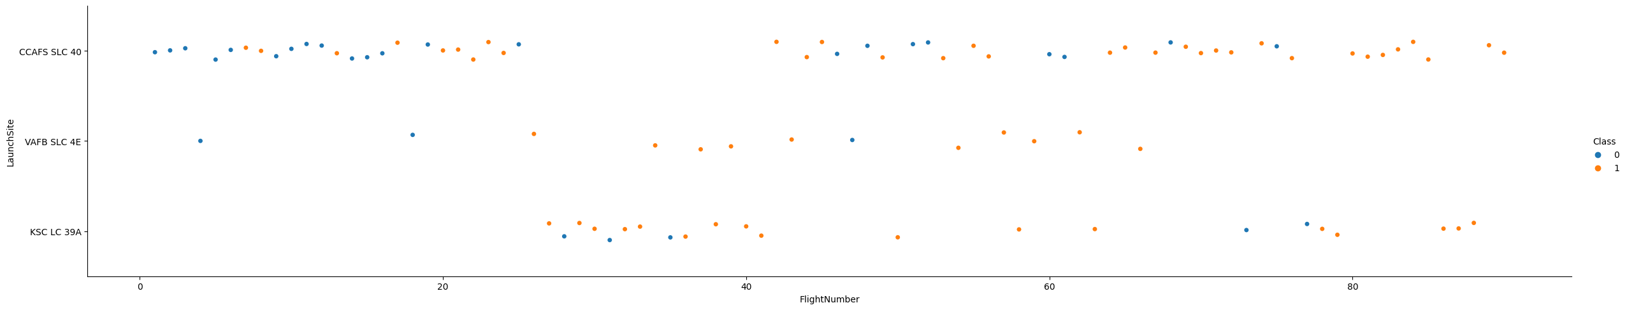
Flight Number vs. Launch Site
Within the scatterplot, 0 represents failed first-stage landings, and 1 represents successful first-stage landings
It’s clear that the higher the flight number (i.e. the later the launch occurred in time), the more likely the first-stage landing would be successful (which corroborates the improvements across time we saw in our other exploratory data analysis visualizations!)

Slide 19
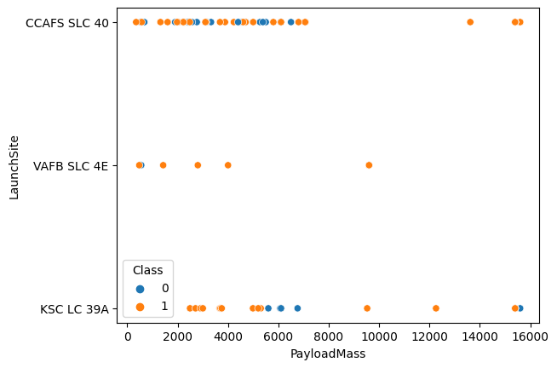
Payload vs. Launch Site
The greatest number of launches have occurred at the CCAFS SLC-40 launch site, and at that location, rockets with payloads between 12000 and 16000 kilograms.

Slide 20
Success Rate vs. Orbit Type
The most successful orbit types include GEO, HEO, SSO, and ES-L1.
The least successful orbit type is GTO.

Slide 21
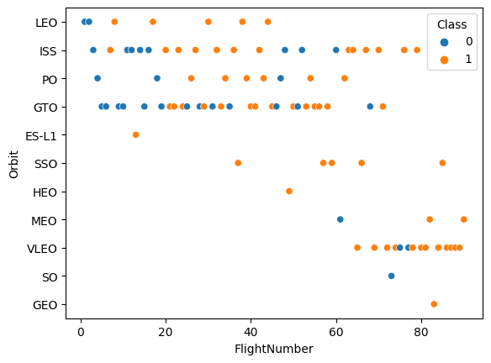
Flight Number vs. Orbit Type
With this visualization, it’s clearer to see why certain orbits have been more or less successful overall.
SpaceX has seemed to transition towards the majority of their later launches and flights being VELO orbits.

Slide 22
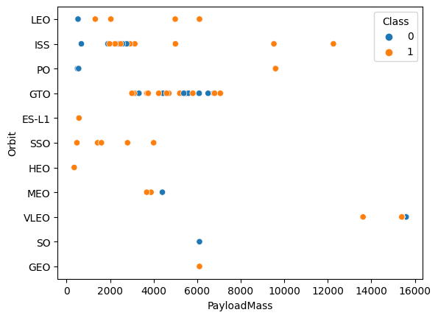
Payload vs. Orbit Type
However, there’s no clear relationship between the payload mass and the type of orbit.

Slide 23
Launch Success Yearly Trend
Fortunately, the proportion of launch successes has increased consistently from 2013 onwards.
The y-axis represents a decimal proportion of successful launches (if multiplied by 100, you would retrieve a percentage).

Slide 24
All Launch Site Names
The distinct launch sites include:
CCAFS LC-40
VAFG SLC-4E
KSC LC-39A
CCAFS SLC-40
This was most evident through the following SQL query:
SELECT DISTINCT Launch_Site FROM SPACEXTABLE;

Slide 25
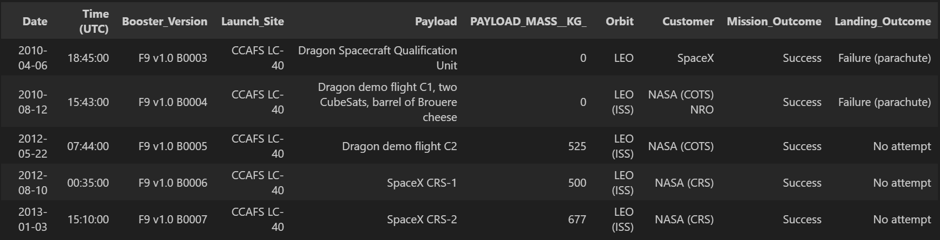
Launch Site Names Begin with 'CCA'
Here are 5 launch records whose site names began with “CCA”:

Slide 26
Total Payload Mass
The total payload mass carried by all NASA boosters amounted to 99,980 kilograms across launches from 2010 – 2020.
In this case, NASA was a customer of SpaceX that utilized certain launches for their own purposes.

Slide 27
Average Payload Mass by F9 v1.1
The average payload mass carried by booster version F9 v1 was 2,534.67 kilograms.

Slide 28
First Successful Ground Landing Date
The first successful landing outcome on ground pad occurred on December 22nd, 2015.

Slide 29
Successful Drone Ship Landing with Payload between 4000 and 6000
The boosters which have successfully landed on a drone ship and had payload mass greater than 4000 but less than 6000 kilograms include:
F9 FT B1022
F9 FT B1026
F9 FT B1021.2
F9 FT B1031.2

Slide 30
Total Number of Successful and Failure Mission Outcomes
The total number of successful missions has been: 100 outcomes.
The total number of failed missions has been: 1 outcome.

Slide 31
Boosters Carried Maximum Payload
The booster versions that have carried the maximum payload mass have been:
F9 B5 B1048.4
F9 B5 B1049.4
F9 B5 B1051.3
F9 B5 B1056.4
F9 B5 B1048.5
F9 B5 B1051.4
F9 B5 B1049.5
F9 B5 B1060.2
F9 B5 B1058.3
F9 B5 B1051.6
F9 B5 B1060.3
F9 B5 B1049.7

Slide 32
2015 Launch Records
Here are the failed drone ship landing outcomes in the year 2015.
Landing_Outcome | Month | Booster_Version | Launch_Site
Failure (drone ship) | April | F9 v1.1 B1015 | CCAFS LC-40
Failure (drone ship) | October | F9 v1.1 B1012 | CCAFS LC-40

Slide 33
Rank Landing Outcomes Between 2010-06-04 and 2017-03-20
In descending order, here are the ranked landing outcomes between June 4th, 2010, and March 20th, 2017:
Landing_Outcome | Count
No attempt | 10
Success (ground pad) | 5
Success (drone ship) | 5
Failure (drone ship) | 5
Controlled (ocean) | 3
Uncontrolled (ocean) | 2
Precluded (drone ship) | 1
Failure (parachute) | 1

Slide 34

Section 3

Slide 35
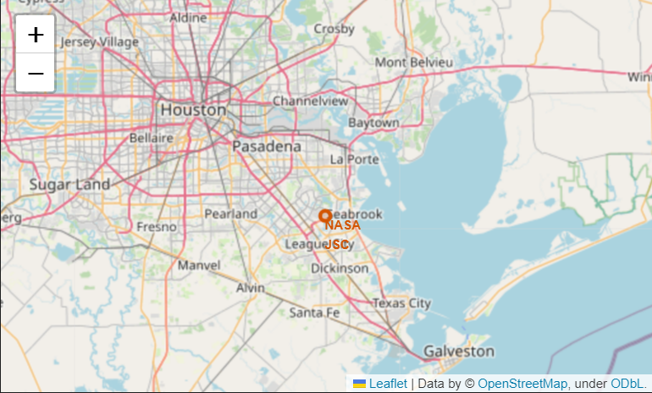
Texas Launch Site(s)
One Launch Site is the NASA Johnson Space Center in Houston, Texas:

Slide 36
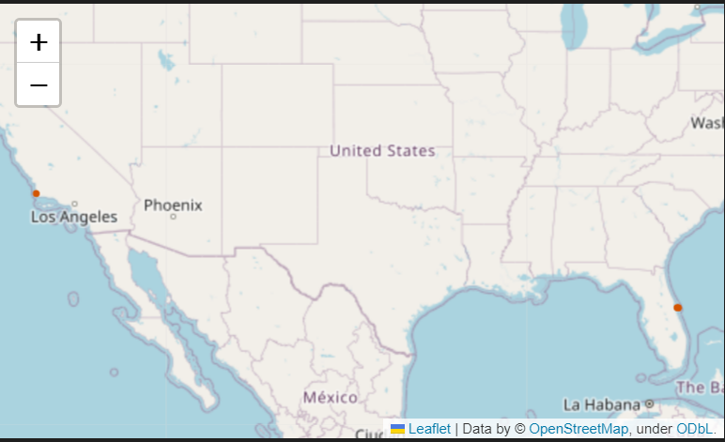
Additional Launch Sites
Additional Launch Sites have been located near the costs of California and Florida:

Slide 37
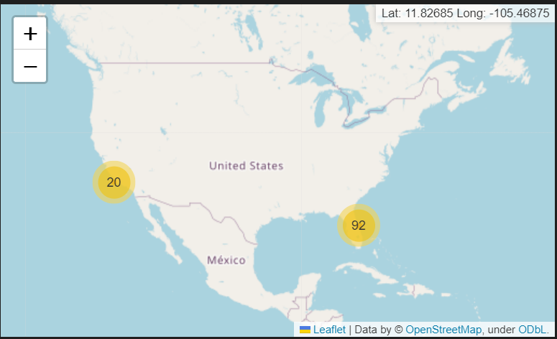
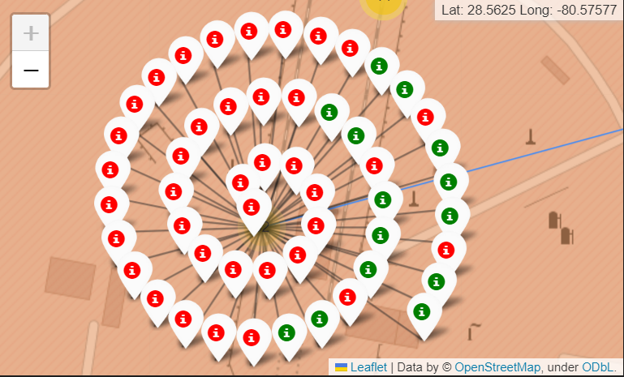
Launch Successes and Failures
With Folium, we can visualize the total number and relative status of launches across our dataset.
Most launches have taken place across the coast of Florida.
In addition, these launches have been further split into several sub-cluster locations. We have visualized the successes and failures of certain launches at the most common launch site in Florida.

Slide 38

Section 4

Slide 39
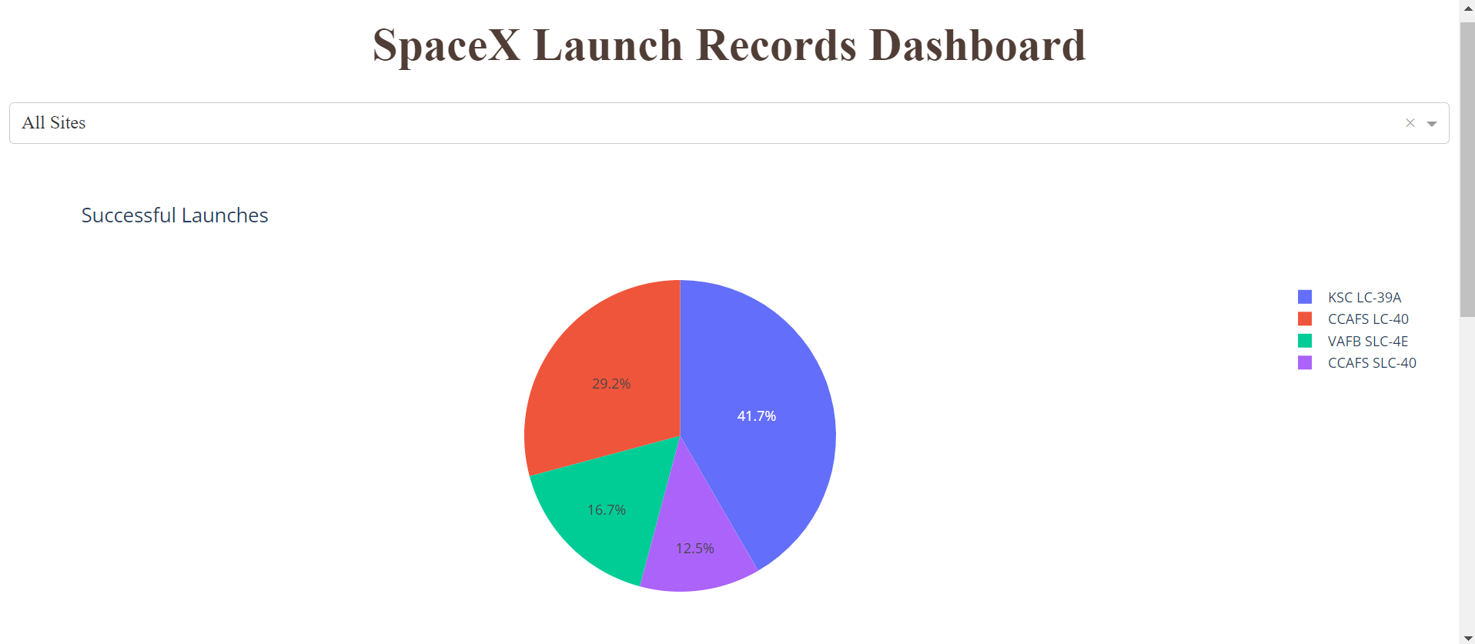
A significant portion of successful launches have taken place at the KSC LC-39A Launch Site.
Successful Launches, Total

Slide 40
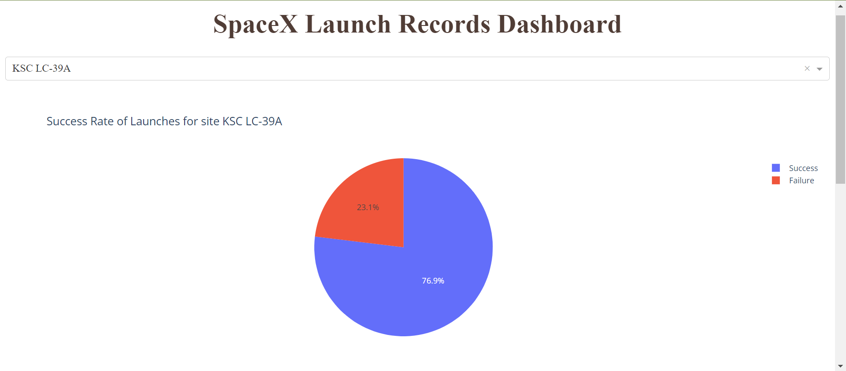
The KSC LC-39A Launch Site also has the greatest proportion of successful launches, with over 70% of launches being positive.
Highest Success Rates

Slide 41
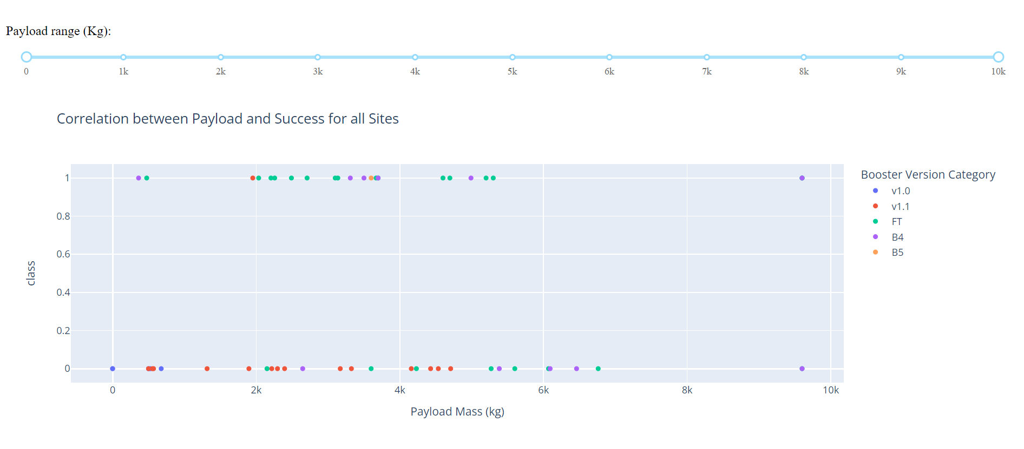
Payload vs. Launch Outcome
We have also visualized the relationship between payload mass and launch outcomes. Here is a screenshot of the scatterplot with the entire range of possible payloads for all launch sites within the dataset.

Slide 42

Section 5

Slide 43
Classification Accuracy
The bar chart demonstrates the classification accuracy for the four machine learning models utilized for prediction.
It is clear that the Decision Tree Classifier performed best on our dataset.

Slide 44

Confusion Matrix
While the Decision Tree Classifier performed best, its weakness was false positives: predicting that a certain landing was successful when in fact it wasn’t.

Slide 45
Conclusions + Appendix
Determining the importance of factors such as the size of the payload, the location of the launch site, the date the launch occurred, etc. can allow us to make better predictions about whether the first stage of a SpaceX rocket launch and landing will be successful or not.
All the demonstrated notebooks are stored on a master public GitHub repository, which can be accessed through this link.

Slide 46


